Slide 1
Application of Markov Chains in Linear Algebra
By
Aanchal Dusija A009
Navika Kapoor A014
Swasti Desai A005

Slide 2
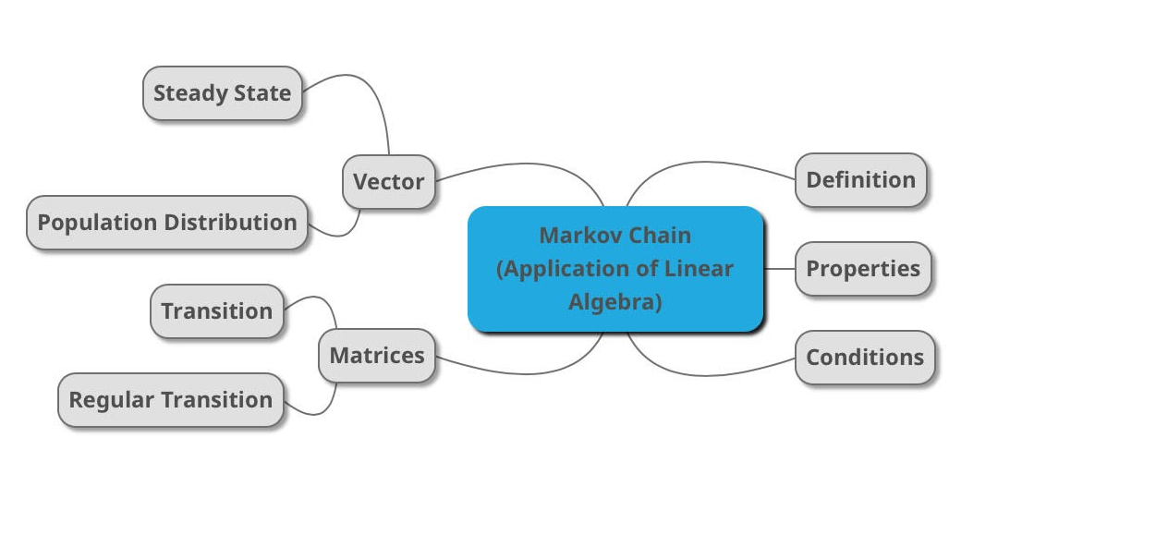
Topics to be covered

Slide 3
Markov Chains
Markov chains are named after Russian mathematician Andrei Markov.
Markov Chains is a stochastic model that describes the probability of transition among the states of a system.
It deals with a sequence of events based on the probabilities dictating the motion of population among various states.

Slide 4
Meaning of Markov Chains
The change of state depends probabistically only on the current state of system.
It is independent of the past given that the present state is known. The behavior depends on the structure of the transition matrix.
It is used in speech recognition, computing microbiology, data compression, pattern recognition and several areas of artificial intelligence.

Slide 5



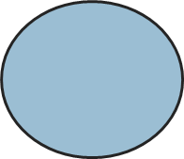
Working of Markov Chains
A
B

Slide 6
Conditions of Markov Chains
In Markov process, there are 2 necessary conditions:
The total population remains fixed.
The population of the given state can never become negative.

Slide 7
Properties of Markov Chains
0.6
A
0.2
B
0.4
0.8

Slide 8
Properties of Markov Chains
The Markov chain uses a n x n transition matrix.
The sum of each matrix column is equal to 1.
All matrix values are non-negative in nature.
Each column is a probability density function. The element in row A and column B is the probability that if the current state is A, it will go to B.

Slide 9
Transition Matrix
The transition matrix T is comprised of elements, denoted tij, relating the motion of a population from state j to state i.
t₁₁ t₁₂ t₁₃
T = t₂₁ t₂₂ t₂₃
t₃₁ t₃₂ t₃₃
A given clement, t₂₃ for example, describes the likelihood that a member of the population moves from state 3 to state 2.

Slide 10
Population Distribution Vector
An element P_{i} of such a vector provides the probability that a member of the population exists in the i^{th} state.
Similar to the requirements, on the transition matrix, the sum of the entries in p must add to 1 and be nonnegative.
p₁
p = p₂
.
.
p_{n}

Slide 11
Application of Transition Matrix to Population Distribution Vector
Application of a transition matrix to a population vector provides the population distribution at a later time.
If the transition matrix remains valid over n time intervals, the population distribution at time n is given by T^{n}p.
p₁ = T*p₀
p₂ = T*p₁ = T(Tp₀) = T²p₀
.
.
p_{n} = T*p_{n-1} = T^{n}p₀

Slide 12
Regular Transition Matrix
A regular transition matrix is one which, when the original matrix T is raised to some power n, which has no zero entries.
For such a matrix, the populations will eventually approach a steady-state(s)
This doesn’t imply that the population is stagnant.
Ts = s

Slide 13
Steady State Vector
The vector s is known as a steady-state vector. Rearranging the equation yields:
Steady State vector means that further application of the transition matrix will produce no noticeable population changes.
The last line is just a homogeneous linear equation which can be solved easily by a row reduction on the augmented matrix [T – I|0].
Ts – s = 0
Ts – Is = 0
(T-I)s = 0

Slide 14
Eigenvalue and eigenvector
The eigenvector function is |T- λ X| = 0.
We examine this equation where λ = 1.
As such, a regular transition matrix T is shown to have eigenvector s with Eigenvalue λ = 1.

Slide 15
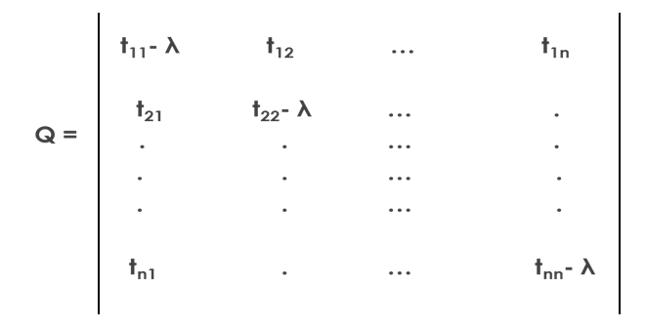
Usage of eigenvalue and eigenvector
To prove this, we begin with an n x n transition matrix whose characteristic polynomial Q = |T – I| can be shown in matrix form.
When λ value is subtracted from the matrix, the sum of each column equals to 0, instead of 1

Slide 16
Application of Markov Chains in Maharashtra Elections
A transition Matrix for the general elections of Maharashtra 2009 and 2014 was made.
Five parties were taken under consideration,
Bharatiya Janata Party (B)
Indian National Congress (I)
Nationalist Congress Party (N)
Shiv Sena (S)
Other parties (O)

Slide 17
Working of the example
S
N
B
O
I

Slide 18
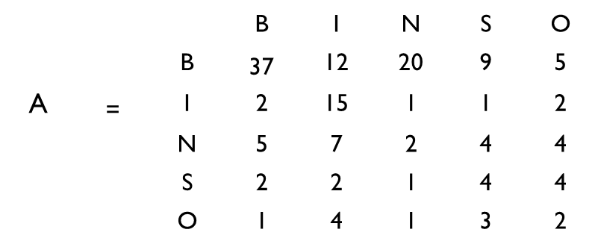
Data Collected
A survey of 150 people who voted in the 2009 general elections of Maharashtra was undertaken.
It was observed that of those that voted for B in the previous elections, 37 voted for B, 2 voted for I, 5 voted for N, 2 voted for S and 1 voted for O in the year 2014.
Link MC.xlsx

Slide 19
Transition Matrix of General Elections of Maharashtra
From the data collected, the transition matrix has been computed as follows:
 |  | B | I | N | S | O
 | B | 0.7872340 | 0.3 | 0.8 | 0.4285714 | 0.2941176
 | I | 0.0425532 | 0.375 | 0.040 | 0.0476190 | 0.1176471
T = | N | 0.1063830 | 0.175 | 0.080 | 0.1904762 | 0.2352941
 | S | 0.0425532 | 0.05 | 0.040 | 0.1904762 | 0.2352941
 | O | 0.0212766 | 0.10 | 0.040 | 0.1428571 | 0.1176471

Slide 20
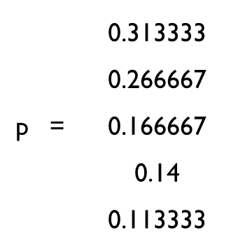
Population Distribution Matrix of General Elections of Maharashtra
In the 2009 election, the voters were distributed according to the distribution vector.

Slide 21
Outcome of the General Elections 2014
In order to get the result for the 2014 general elections, the transition matrix is multiplied by the Population Distribution Vector. The result is as follows:
B I N S O
B 0.787234043 0.3 0.8 0.428571429 0.294117647
I 0.042553191 0.375 0.04 0.047619048 0.117647059
N 0.106382979 0.175 0.08 0.19047619 0.235294118
S 0.042553191 0.05 0.04 0.19047619 0.235294118
O 0.021276596 0.1 0.04 0.142857143 0.117647059
0.313333 0.553333
0.266667 0.14
0.166667 0.146667
0.14 0.086667
0.113333 0.073333

Slide 22
Outcome of the General Elections 2014
Voting Parties | Percentage of Votes
Bharatiya Janata Party | 55.33%
Indian National Congress | 14%
Nationalist Congress Party | 14.67%
Shiv Sena | 8.67%
Others | 7.33%

Slide 23
Outcome of the General Elections 2019
In order to get the result for the 2019 general elections, the transition matrix is multiplied by the Population Distribution Vector. The result is as follows:
2
B I N S O
B 0.787234043 0.3 0.8 0.428571429 0.294117647
I 0.042553191 0.375 0.04 0.047619048 0.117647059
N 0.106382979 0.175 0.08 0.19047619 0.235294118
S 0.042553191 0.05 0.04 0.19047619 0.235294118
O 0.021276596 0.1 0.04 0.142857143 0.117647059
0.313333 0.6536
0.266667 0.0947
0.166667 0.1289
0.14 0.0702
0.113333 0.0526

Slide 24
Outcome of the General Elections 2019
Voting Parties | Percentage of Votes
Bharatiya Janata Party | 65%
Indian National Congress | 10%
Nationalist Congress Party | 13%
Shiv Sena | 7%
Others | 5%

Slide 25
Eigenvalue and eigenvector
The following function is used |T- λ X| = 0 where λ = 1
0.7872340 | 0.3 | 0.8 | 0.4285714 | 0.2941176
0.0425532 | 0.375 | 0.040 | 0.0476190 | 0.1176471
0.1063830 | 0.175 | 0.080 | 0.1904762 | 0.2352941
0.0425532 | 0.05 | 0.040 | 0.1904762 | 0.2352941
0.0212766 | 0.10 | .040 | 0.1428571 | 0.1176471
1 | 0 | 0 | 0 | 0
0 | 1 | 0 | 0 | 0
0 | 0 | 1 | 0 | 0
0 | 0 | 0 | 1 | 0
0 | 0 | 0 | 0 | 1
-0.212765957 | 0.3 | 0.8 | 0.428571 | 0.294118
0.042553 | -0.625 | 0.04 | 0.047619 | 0.117647
0.10638 | 0.175 | -0.92 | 0.190476 | 0.235294
0.042553 | 0.05 | 0.04 | -0.80952381 | 0.235294
0.021277 | 0.1 | 0.04 | 0.142857 | -0.882352941

Slide 26
Row Echelon Form
We use the Augmented matrix in [T- λX|0] where λ = 1
-0.212766 | 0.3 | 0.8 | 0.428571 | 0.294118 | 0
0.042553 | -0.625 | 0.04 | 0.047619 | 0.117647 | 0
0.10638 | 0.175 | -0.92 | 0.190476 | 0.235294 | 0
0.042553 | 0.05 | 0.04 | -0.809524 | 0.235294 | 0
0.021277 | 0.1 | 0.04 | 0.142857 | -0.882353 | 0
~
-0.21 | 0.3 | 0.8 | 0.43 | 0.29 | 0
0.04 | -0.63 | 0.04 | 0.05 | 0.12 | 0
0.11 | 0.18 | -0.92 | 0.19 | 0.24 | 0
0.04 | 0.05 | 0.04 | -0.81 | 0.24 | 0
0.02 | 0.1 | 0.04 | 0.14 | -0.88 | 0
-21 | 30 | 80 | 43 | 29 | 0
4 | -63 | 4 | 5 | 12 | 0
11 | 18 | -92 | 19 | 24 | 0
4 | 5 | 4 | -81 | 24 | 0
2 | 10 | 4 | 14 | -88 | 0
0 0 0 -18.844 0
0 1 0 0 -1.68914 0
0 0 1 0 -3.15149 0
0 0 0 1 -1.48676 0
0 0 0 0 0 0
~

Slide 27

Steady State Vector Outcome
We see that BJP = 18.844, INC = 1.68914, NCP = 3.15149, SS = 1.48676 and O is a free variable.
In order to transform this into a valid population vector (with the sum of the entries equal to 1), the entries are summed and then each is divided by the result.
0.7200 72
0.0645 6.45
0.1204 12.04
0.0568 5.68
0.0382 3.82
$$≈$$

Slide 28
Steady State Vector Outcome
Voting Parties | Percentage of Votes
Bharatiya Janata Party | 72%
Indian National Congress | 6.45%
Nationalist Congress Party | 12.04%
Shiv Sena | 5.68%
Others | 3.82%

Slide 29
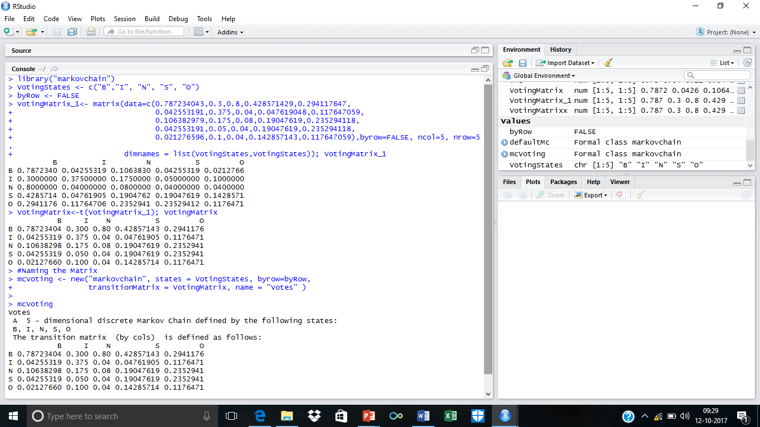
R Codes

Slide 30
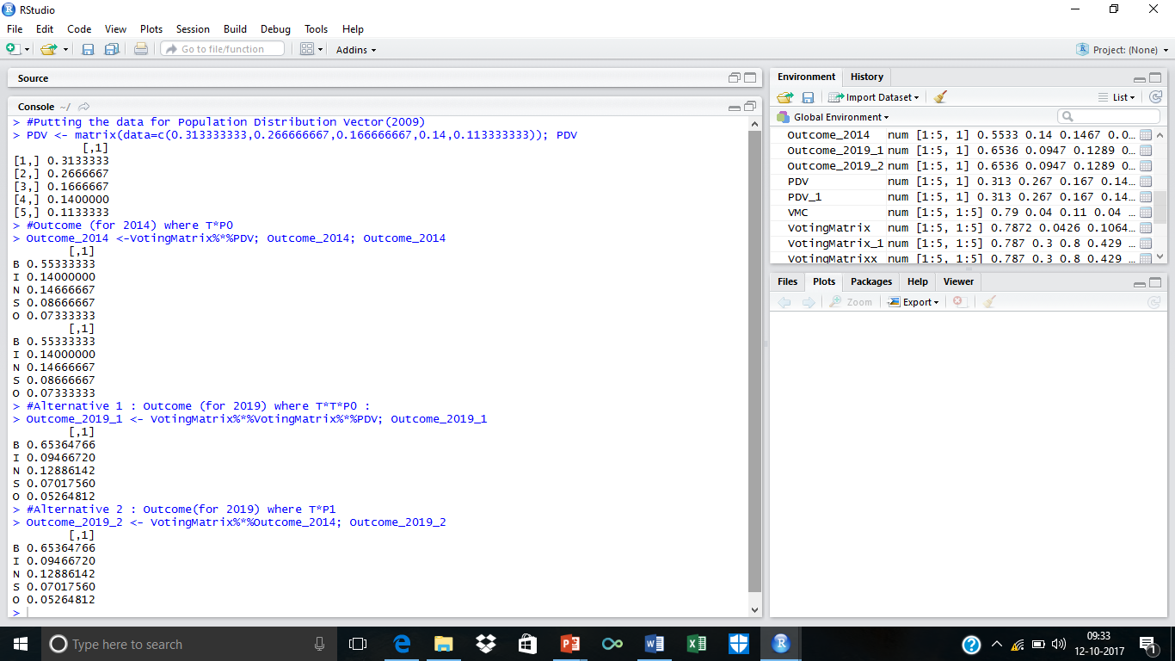
R Codes

Slide 31
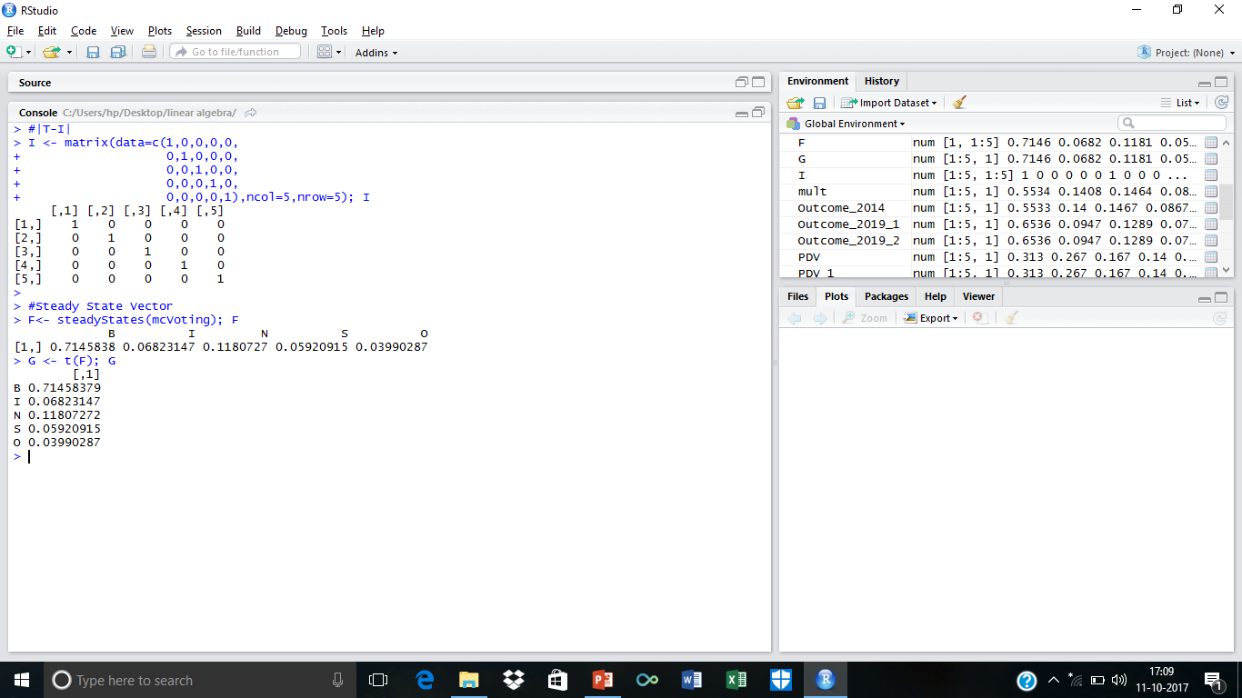
R Codes

Slide 32
Conclusion
Markov chains which are dynamical systems exist in many fields.
One main assumption of Markov chains, that only the immediate history affects the next outcome, does not account for all variables observed in the real world.
Nevertheless, the model affords us with good insight and perhaps serves as a helpful starting point from which more complicated and inclusive models can be developed.

Slide 33
Limitations
The outcome that is received is not accurate but it gives us a glimpse of the forthcoming.
The sample size is small.
The tastes and preferences of people change as they are prone to influence.
The voter's view of the incumbent's previous performance.

Slide 34
Future Scope
A larger sample can be taken in order to get a more accurate outcome.
The sample can take into consideration various variables such as rural and urban areas, demographics, different states in Maharashtra
Markov chains can be used for predicting future voting trends and can take into consideration canvassing, advertising, past performance etc.

Slide 35
References
http://www2.kenyon.edu/Depts/Math/hartlaub/Math224%20Fall2008/Markov-Sample2.pdf
http://setosa.io/ev/markov-chains/
Lay, David C. Linear Algebra and Its Applications, Third Edition Update. Pearson Education, Inc. 2006
https://cran.r-project.org/web/packages/markovchain/vignettes/an_introduction_to_markovchain_package.pdf
Anton, Howard and Chris Rorres. Elementary Linear Algebra Applications Version, Ninth Edition. John Wiley & Sons, Inc. 1973.

Slide 36
Acknowledgement
We express our sincere respect and gratitude to our mentors Mr. Prashant Dhamale and Ms. Ashita Dara who have given us their valuable support, co-operation and suggestions from time to time in successfully completing this project work.

Slide 37
THANK YOU

